Slide 1


ShoutOutforSEND@buckinghamshire.gov.uk
Notes from November meeting 11.11.2024

Slide 2



Young People’s Plan, Action 2: SEND in PSHE
Our first item was to tackle Action 2 from our Young People’s Plan, Campaigning for schools to teach students about SEND in PSHE lessons:
We took part in group interviews, discussions and wrote down our thoughts on this topic
The next few slides share our perspectives on this action

Slide 3

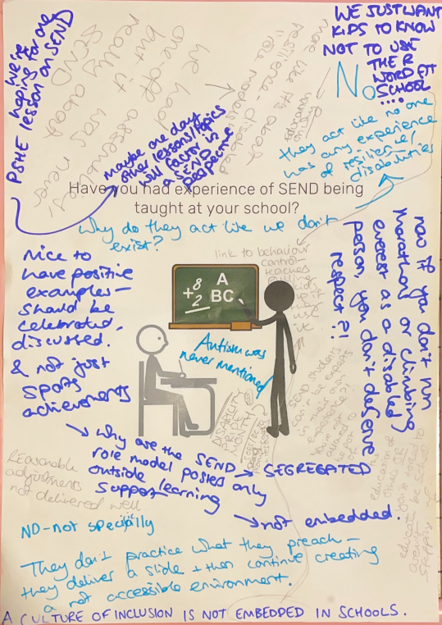


Slide 4




Our experiences of SEND being taught in school
“We’ve never been taught about SEND in school
It’s nice to have positive examples of people with SEND on posters, but they are never celebrated or talked about. If it is talked about its always sporting achievements and nothing else
‘You either run marathons or you don’t count’
Why are these kinds of posters only outside learning
support? It shows how understanding of SEND is not
embedded

Slide 5


Our experiences of SEND being taught in school
“We’re just hoping for one PSHE lesson on SEND, and maybe one day other lessons (in PSHE and beyond) will factor in the SEND perspective
We had a one-off assembly but it wasn’t really about SEND it was more about resilience, disabled role models and sport.
We just want kids to know not to use the ‘R’ word at
school, and education on why, including teachers pulling
up people when they use it.

Slide 6
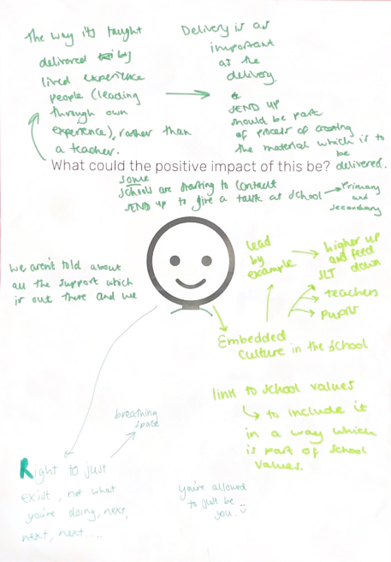

Slide 7
Positive impact of SEND in PSHE
It would give us the right to exist, allowing you to be you
This is a very impactful subject that will help so many people
Giving people knowledge changes attitudes, my classmates might think ‘maybe I should ease up on this person’
It could link to school values, schools can show their values by
including this in their curriculum
It could help people get the support they need (including a
diagnosis) at an earlier stage

Slide 8
Positive impact of SEND in PSHE
All schools (secondary) have students who can deliver lessons like this, if they are supported and given the safe space to do it
Many of us aren’t told about the support that’s out there, this will help that
When I was in primary school, I had 1:1 support and I didn’t understand why I was different. Being taught these kinds of
things in primary school would have helped me understand
who I am
It would embed an inclusive culture in the school, leading by
example from top down (SLT, then teachers, then pupils)

Slide 9
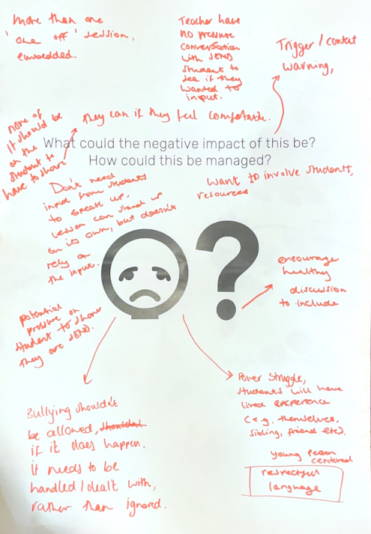

Slide 10
Possible negative impacts of SEND in PSHE
SEND students may feel like they have to contribute. The lesson should stand on it’s own but also have the space for people to share their views if they want.
It has to be young person centred around respectful language
It could increase bullying if delivered badly by a teacher. But
this session gives teachers/students something to refer to
when bullying does happen
People might learn about it and try to fake having
autism/ADHD for attention or other reasons

Slide 11
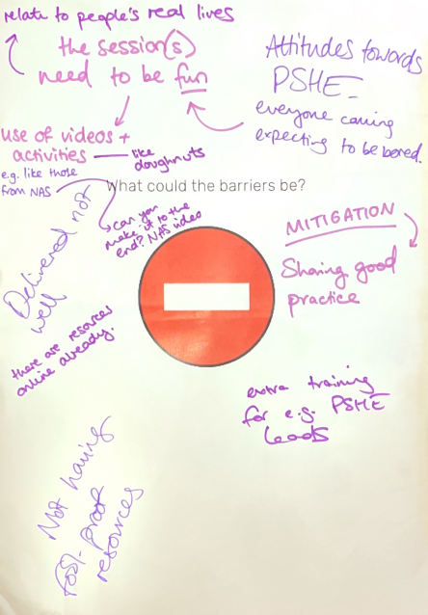

Slide 12
Barriers that might impact our idea
Getting these sessions to children early. The later you introduce this, the harder it can be to change minds.
Teachers need to be confident in teaching this, some teachers might have the wrong approach which could make things worse. Training can help.
Attitudes towards PSHE. Students might join expecting to be
spoken at/bored. The session needs to be fun and relate to
real life. There are amazing resources already online (including
the National Autistic Society)

Slide 13
Next steps for Action 2
SOfS Reps to meet with Carol to discuss our points
Carol to share our voices to all PSHE leads across Buckinghamshire
Our Co-chairs, Serena and Pippa to send an open letter to the Department for Education to campaign for this to be included in the national curriculum (deadline 22 November)

