Slide 1


ShoutOutforSEND@buckinghamshire.gov.uk
Notes from kick-off meeting 15.07.2024

Slide 2


Kick-off meeting aims
To launch a new working relationship between Shout Out for SEND (SOfS) Reps and decision-makers from Buckinghamshire's SEND Partnership Board (SPB)
For SOfS Reps and SPB members to discuss and prioritise actions for a Children and Young People’s (CYP) Plan. This will be the plan that SOfS will be working on over the next year.

Slide 3

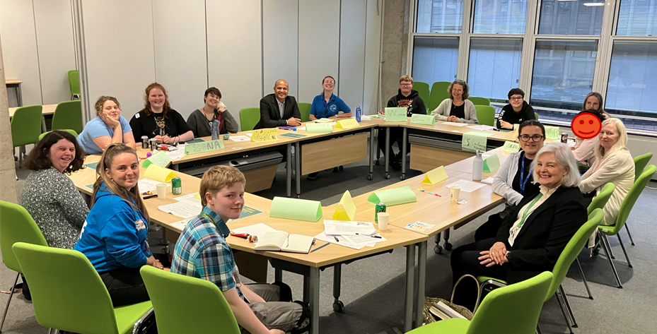

Who attended the kick-off meeting?
Michael
Caroline H
Iona
Krissie
9 SOfS Reps
4 members of the SEND Partnership Board (SPB)
4 facilitators from the Youth Voice Bucks team
Will
Louise
Chloe
Willow
Cadence
Laura
Serena
Lucy
Caroline M
Angel
Anita
Pippa
Sam

Slide 4

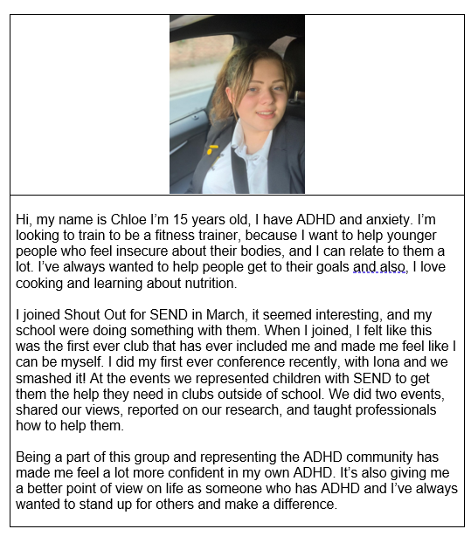

Item 1 – Reps Bios
To start us off, the SOfS Reps shared information all about themselves to everyone in the room, presented as bios.
Here is Chloe’s as an example
All our Reps bios are now live on the Youth Voice Bucks website. You can read them here.

Slide 5
Item 2 – Hot Seat
It was then the turn for the senior staff to introduce themselves. They all shared how keen they were to be at the meeting and to hear the voices of the young people!
Michael Jarrett – Service Director for Education, Children’s Services
Michael explained his role and what is important to him. Michael talked about his two children and that he missed an important family event to be with all the SOfS reps!
Caroline Hart – Designated Clinical Officer, Adults and Health Directorate
Caroline discussed her job and some of the issues the healthcare system is facing at the moment.
Caroline Marriott – Head of Integrated SEND, Children’s Services
Caroline spoke about her role and what integrated SEND is.
Cllr Anita Cranmer - Cabinet Member, Education and Children's Services
Cllr Anita shared what being a councilor means, and that youth voice is really important in influencing change.

Slide 6




Will’s category game
We then had a movement break, which was led by a SOfS Rep, Will!
Everyone had a sticker on themselves with names like Harry, Ron or Hermione. Everyone had to work as a group to find their team, helping each other along the way!
Attendees stayed in these teams for the next activity…

Slide 7
Item 3 – CYP Plan
The teams worked together to discuss priorities for the CYP plan.
Groups worked on stations which matched the local area’s workstreams; preparing for adulthood, early support, education and high support needs.
At these stations, Reps and SPB members discussed potential solutions to their priorities, considering how they would work practically and the importance of them.
At the end of the activity, attendees voted on the solutions they thought were most important and would have the best impact to include in the CYP Plan

Slide 8
Item 3 – CYP Plan: Output from votes on solutions
Out of the 11 solutions, these had the most votes and will be included in the CYP Plan:
Solutions for CYP Plan | Reps votes | SPB votes | Total
Create a training module for teachers on autism awareness, with young people’s experiences at the centre | 9 | 1 | 10
Explore how young people’s access to mental health support can be better | 7 | 1 | 8
Carry out research on how professionals can support young people in transitioning through different stages of their life | 5 | 2 | 7
Create a Preparing for Adulthood course | 4 | 4 | 8
Schools to teach all students about SEND in PSHE lessons | 4 | 4 | 8

Slide 9
Item 3 – CYP Plan: Output from votes on solutions
During discussions, it was decided that we will weave these ideas into the programme for the year, rather than naming them as actions in the CYP Plan.
Ideas for CYP Plan | Reps votes | SPB votes | Total
Create a project request form for young people (Reps and others) | 2 | 3 | 5
Create a clear feedback loop between young people and the council | 2 | 1 | 3

Slide 10
Item 3 – CYP Plan: Output from votes on solutions
Out of the 11 solutions, the below 8 had the least votes, and may not be included in the CYP Plan:
Reps to deliver a presentation/talk at the Inclusion Conference in September
Carry out research/explore why the length of interventions for young people with SEND should be longer to give them more time to build trust
Design an event/training which strengthens relationships with the police and young people with SEND
Reps to create a webinar/resource to train teachers on understanding the legality of reasonable adjustments
Reps to attend and share thoughts and feelings at the SEND Employment Forum
Create a resource/training to help schools provide SEND students with an inclusive ‘environment’

Slide 11
The following slides summarise the key comments from each station on the CYP Plan activity. These (and many others) will be considered when devising the plan.

Slide 12
Key comments (Education)
“Sometimes having no money forces us to work in a different way… If there is a way in which we can work in a more collaborative way with partners, that could have a tremendous impact” (SPB member)
“It’s less about dropping in to deliver training, and more about working with students in schools to integrate an ongoing inclusive culture in all schools, as they are the ones who know what it is like in their environment. I can guarantee that there will be at least 10 CYP in each school who are desperate to do something [like this]” (SOfS Rep)
“It’s essential that we empower and encourage young people to feel safe to speak up and have this ongoing in their lives as if we were parachuted in, it would not have a long term impact.” (SOfS Rep)

Slide 13
Key comments (Education)
“Creating a resource pack for professionals on SEND inclusion” (SOfS Rep)
“I think students need to have a handout that tells them their rights, such as reasonable adjustments, EHCP reviews and what you can ask for, created by us” (SOfS Rep)
“Reasonable adjustment passports, which are used for health and employment should be used more. We could promote the use of these in schools.” (SPB Member)

Slide 14
Key comments (Early Support)
“Continued support is needed and ongoing, not short period of support and then being stopped” (SOfS Rep)
“When SEND isn’t spotted early in school this can make things worse and cause many more challenges for young people, so early start approach is needed for support and spotting SEND” (SPB Member)
“Young people need to be asked about the support they need” (SOfS Rep)

Slide 15
Key comments(Early Support)
“Be given information while waiting for a diagnosis, like a booklet so you can understand more” (SOfS Rep)
“Support and flexibility for people who are awaiting a diagnosis as this can be a long waiting time. Adjustments should be put in place.” (SOfS Rep)
“Better training for teachers around SEND, not just autism as there is a focus on that but there is so much more to SEND support” (SOfS Rep)
“GPs are an ongoing issue for the SEND community. There needs to be a change to GP appointments by having an alternative to a phone call. Reasonable adjustments should be put in place, and be flagged in notes not to have a phone call.” (SOfS Rep)

Slide 16
Key comments (Preparing for Adulthood)
“My school didn’t tell me how to go to college, how to apply to college or what to do! That was really horrible. That was a huge assumption they I wanted to stay.” (SOfS Rep)
“Drop in support for young people and they know what it is, and how to access. You leave school and you are completely lost. Some services have employment transition workers, but that’s not consistent.” (SOfS Rep)
“Supported internships – there are only one or two options. They want to box you in rather than recognising the variety of skills and experiences that we have.” (SOfS Rep)
“It’s a postcode lottery for support with preparing us for adulthood.” (SOfS Rep)

Slide 17
Key comments (High support needs)
Priority – ‘Explore how young people’s access to mental health support can be better’
“Let CAMHS know that we are having to repeat our story constantly.” (SOfS Rep)
“Our experiences with mental health support often involve over-promising from the professional and nothing happens that you have requested” (SOfS Rep)
“We could host a meeting on mental health, and then conduct a study on the key ideas?” (SPB Member)
“Better crisis support is needed as is training for mental health professionals” (SOfS Rep)

Slide 18
Feedback from SOfS Reps
Many Reps shared that they were encouraged that senior staff were keen to meet with them, that they liked sharing their bios and finding out more about staff at the council.
However, the consensus of the group was that there is a long journey to go to make things better for young people with SEND.

Slide 19
Feedback from SPB Members
“It was really good to meet the young people whose voices we hear through other means. There was so much more to say/hear than we had time for and I would be very pleased to meet the young people again. I would also love to see if there was a way to offer the YP voice into one of our GP training events at some point.”
- Caroline Hart
" I enjoyed meeting the SOfS team and was inspired by their personal stories, their wise and mature suggestions for new ways forward and their assessment of need for change for future progress. They deserve our support and as the Cllr for Children's services I pledge to work to make sure they get it.
- Cllr Anita Cranmer

Slide 20
Feedback from SPB Members
“I know I talk for other colleagues when I say how much we all thoroughly enjoyed joining the session with members of the Shout Out for SEND group on 15 July. The session was very well attended, had a dynamic feel and confirmed the council’s commitment to co-production with children and young people. I was particularly heartened by the conversations I had during the round table discussions and at informal points during the evening and I look forward to joining more sessions in the future.”
- Michael Jarrett

Slide 21
CYP Plan – Next steps
The CYP Plan to be drafted by the Youth Voice Bucks team and to have input from the SEND Improvement Manager (TBA)
The CYP Plan to be agreed by SOfS Reps at the summer meeting (3/9/24)
SOfS September meeting to plan the details, including timelines on the CYP Plan (16/9/24)
The finalised CYP Plan to be shared at the SEND Partnership Board (on 30/9/24)

